Slide 1

Introduction to Rust
Phil Willis
@ptbw2000

Slide 2
Brief Introduction
Initially, developed by Graydon Hoare
Mozilla foundation(2009~)
Trait-based and “object orientated“ programming
Zero-cost abstraction
High concurrency support
Memory safety by ownership and lifetime concept

Slide 3
Problem: Memory Safety
Use-after-free (dangling pointer)
Double free
Null pointer dereference
These kind of problems cause not only software crashes, but also security vulnerabilities.

Slide 4
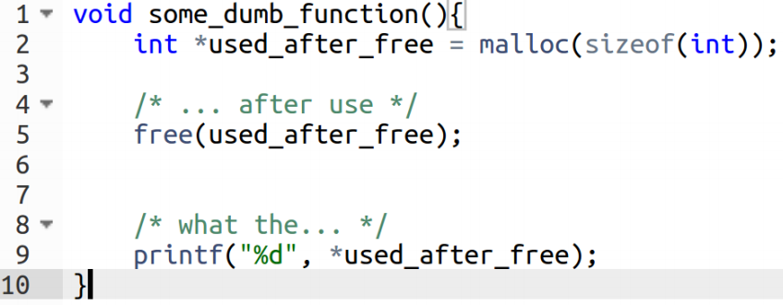
Use-After Free
Simple and trivial case

Slide 5
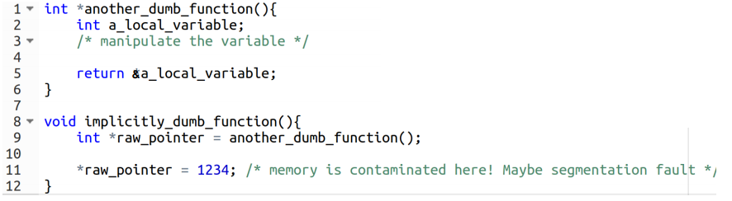
Dangling Pointer
If these two functions are far away from each other, this kind of bugs can be very hard to find.

Slide 6
Garbage Collection
Java, Python, Ruby, C#, Scala, Go...
Programmer creates objects but the computer is responsible to remove them.
There is no explicit malloc and it‘s free – Therefore, no problem?

Slide 7
Garbage Collection
Computer cannot know the exact timing when each object should be freed.
No predictability – cannot used for real-time system
Limited concurrency - global interpreter lock
Larger code size because the GC must included

Slide 8
System Programs
Must be FAST.
Must have minimal runtime overhead.
Must be memory SAFE.
Should be possible to do direct memory access.
Rules out Garbage Collection

Slide 9
Rust Tries to Solve These Issues By
Zero-cost abstraction
Memory safety without garbage collection
Super fast code generation*
C function compatibility (extern "C")
Simpler syntax than C++
* Code that runs fast, not fast generation!

Slide 10
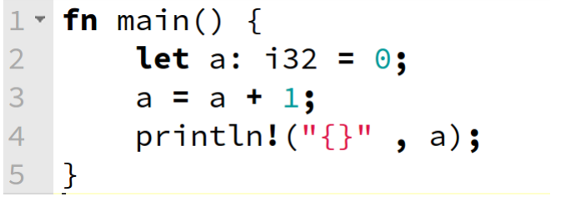
Basic: Mutability
mutability_example

Slide 11
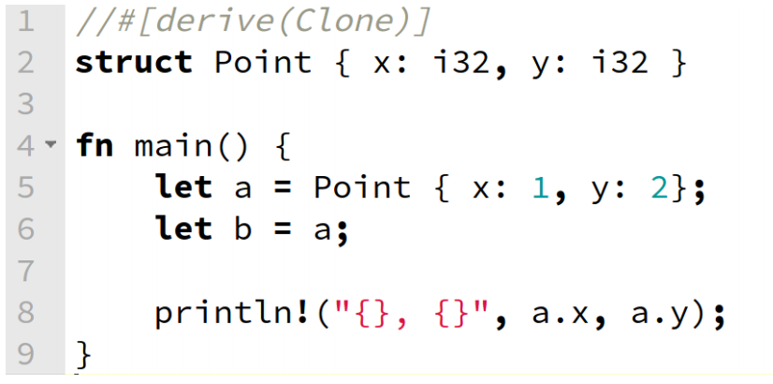
Basic: Move
move_example

Slide 12
Basic: Ownership
There is only ever one owner
Rather than owning the resource, a binding borrows ownership
A binding that borrows something does not deallocate the resource when it goes out of scope
A borrowed resource is immutable
borrow_example

Slide 13
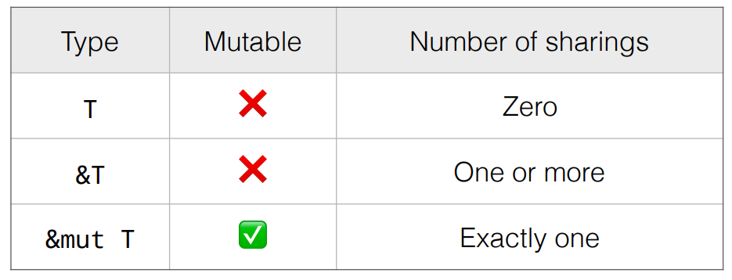
Borrowing: The Rules

Slide 14
Crates: Items and Modules
A crate is a unit of compilation and linking,
as well as versioning, distribution, and runtime loading.
Contains a tree of nested module scopes.
Top level of tree is anonymous and any item within a crate has
a module path denoting its location within the crate’s tree.
Source files: example.rs
Crate files: example.rc

Slide 15
Hello Rust
Cargo package manager and Hello World

Slide 16
Traits
“A trait is a language feature that tells the Rust compiler
about functionality a type must provide.”
https://doc.rust-lang.org
trait_example

Slide 17
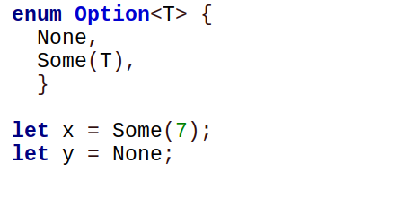
Option Type
Null does not exist in Rust
Rust uses the Option type instead.

Slide 18
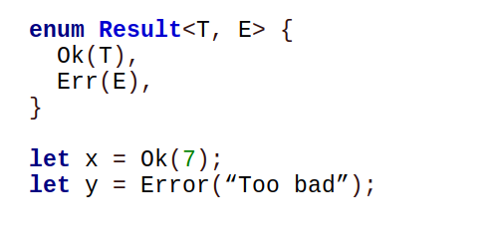
Result Type
Exceptions do not exist in Rust
Rust uses Result type instead

Slide 19
Result Type Cont...
result_example

Slide 20
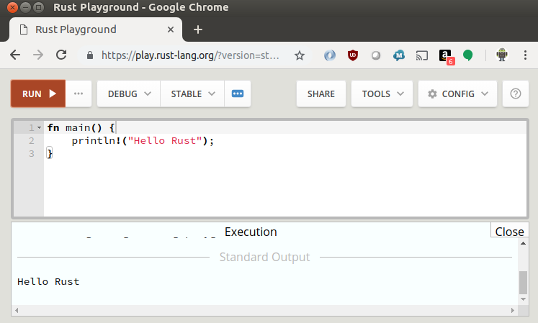
Playground

Slide 21
Ecosystem
Package Manager: cargo
Formater: rustfmt (cargo fmt)
Code completion: racer
Linter: clippy

Slide 22
More Information
http://doc.rust-lang.org/book/
http://github.com/rust-unofficial/awesome-rust
http://crates.io
https://blog.burntsushi.net

